Slide 1
Educational Institutions Management & Monitoring System
Class and Collaboration Diagram
Name Student ID
Kamrul Hasan Shourov 1005097
Mahabub Zoraf 1005106
Aminul Haque Ripon 1005107
Md. Bulbul Sharif 1005108
Ashif Salman Rupsha 1005109

Slide 2
Educational Institutions Management & Monitoring System
Sub Systems:
1. Registration for Primary School Certificate Examination.
2. Monitoring Student’s Performance.
3. Monitoring Teacher’s Performance.
4. Monitoring Institution’s Performance.
5. Book Distribution.

Slide 3
Registration for Primary School Certificate Examination
Use Case: Starting Online Registration

Slide 4
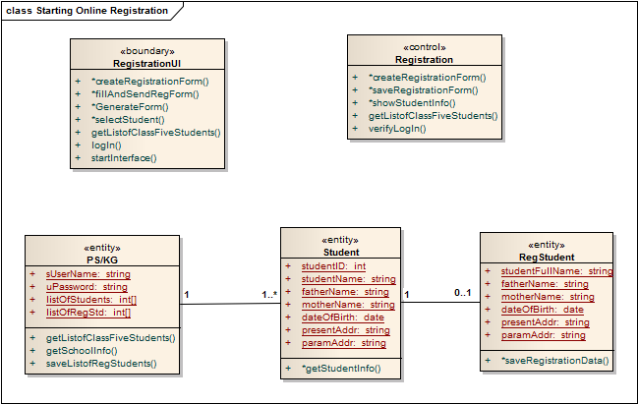

Slide 5
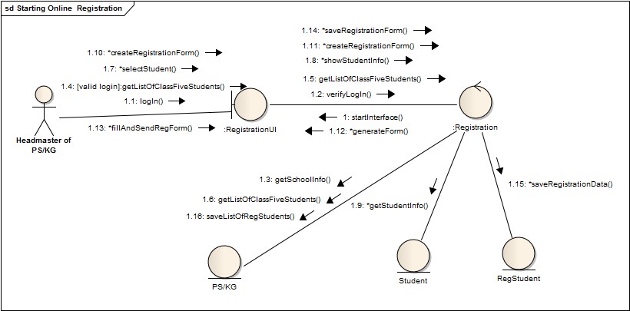

Slide 6
Registration for Primary School Certificate Examination
Use Case: Checking Registration Info

Slide 7
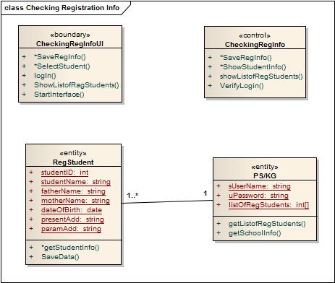

Slide 8
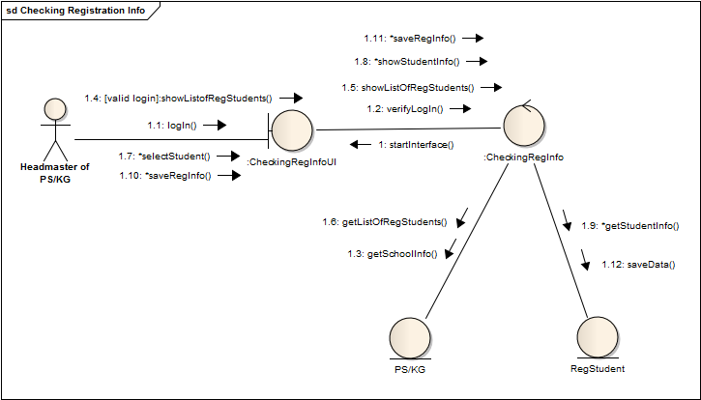

Slide 9
Monitoring Student’s Performance
Use Case: Analyzing Student’s Profile

Slide 10
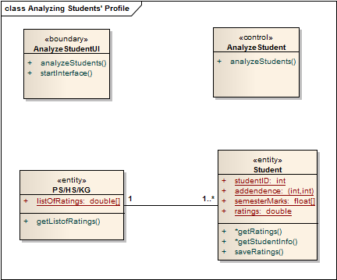

Slide 11
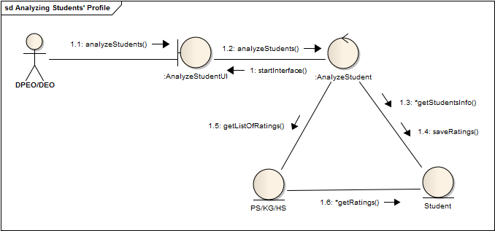

Slide 12
Monitoring Student’s Performance
Use Case: Student’s Performance Monitoring and
Taking Proper Steps

Slide 13
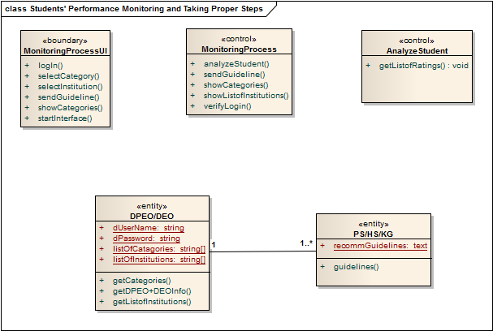

Slide 14
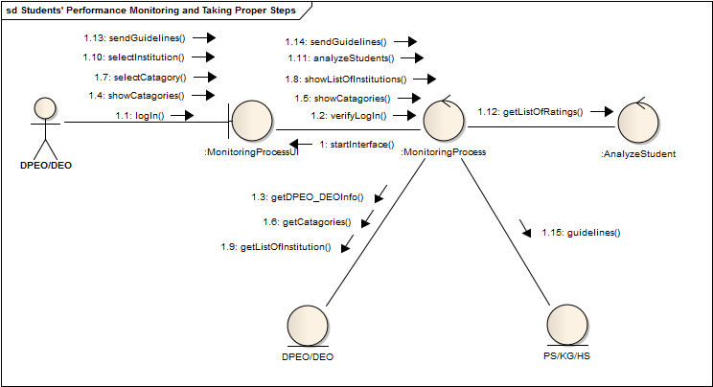

Slide 15
Monitoring Student’s Performance
Use Case: Updating Student’s Profile

Slide 16
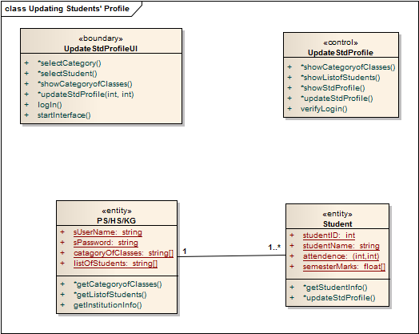

Slide 17
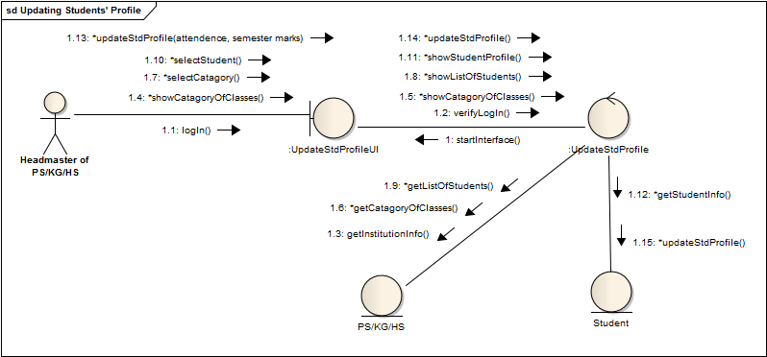

Slide 18
Monitoring Teacher’s Performance
Use case: Analyzing Teacher’s Profile

Slide 19
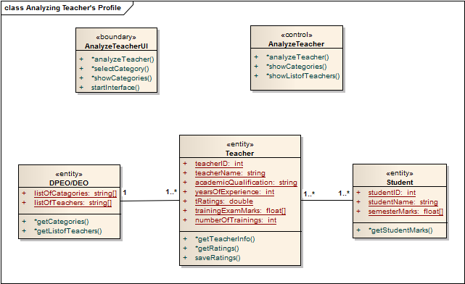

Slide 20
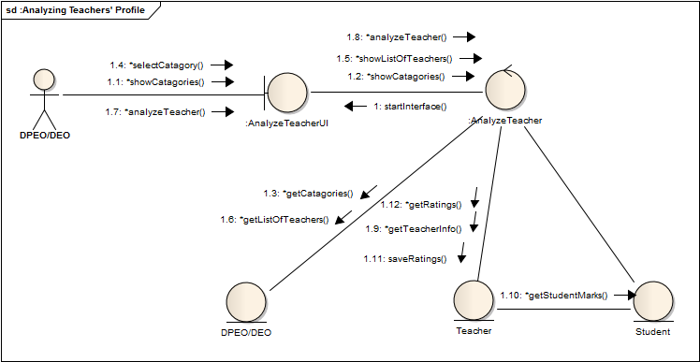

Slide 21
Monitoring Teacher’s Performance
Use case: Training Sessions

Slide 22
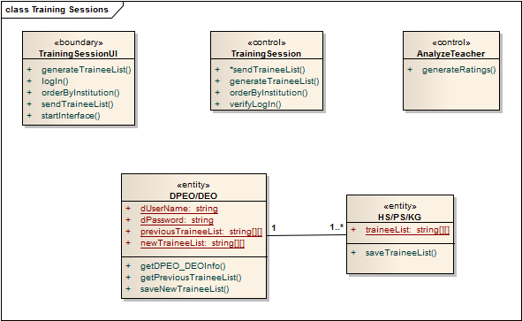

Slide 23
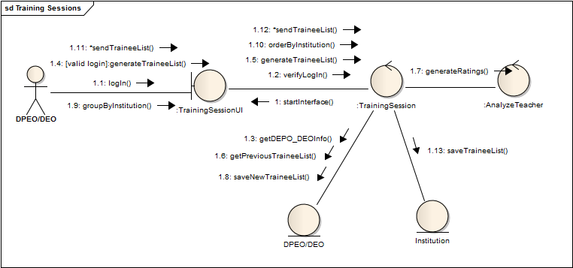

Slide 24
Monitoring Teacher’s Performance
Use Case: Update Trainee’s Profile

Slide 25
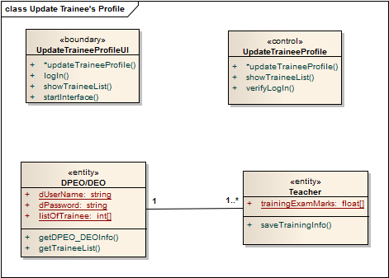

Slide 26
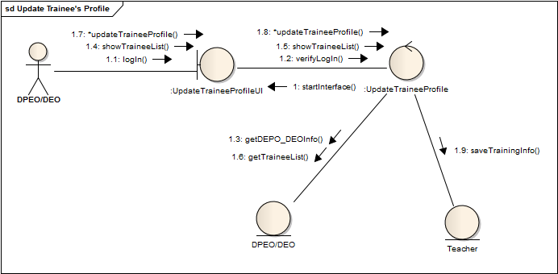

Slide 27
Monitoring Institution’s Performance
Use case: Analyzing Institution’s Profile

Slide 28
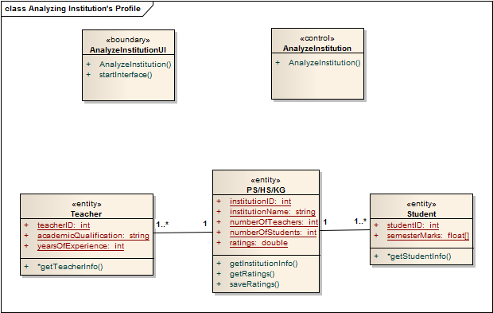

Slide 29
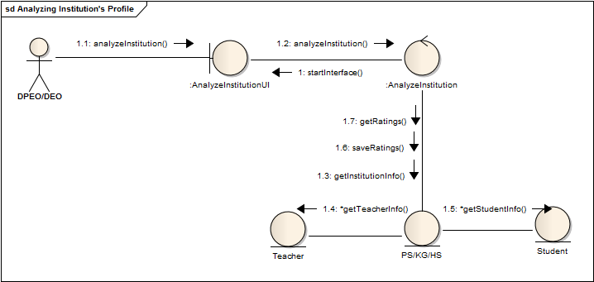

Slide 30
Monitoring Institution’s Performance
Use case: Create New Student’s Profile

Slide 31
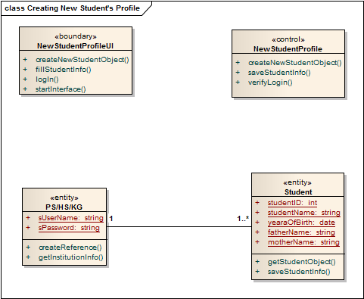

Slide 32
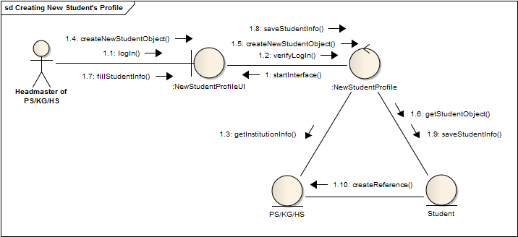

Slide 33
Monitoring Institution’s Performance
Use Case: Create New Teacher’s Profile

Slide 34
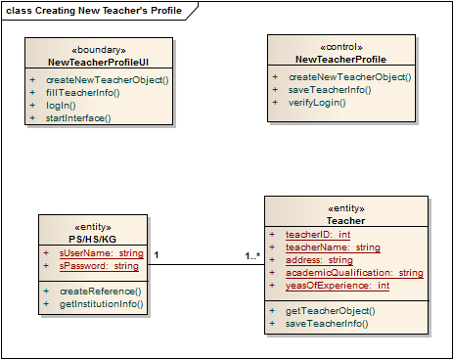

Slide 35
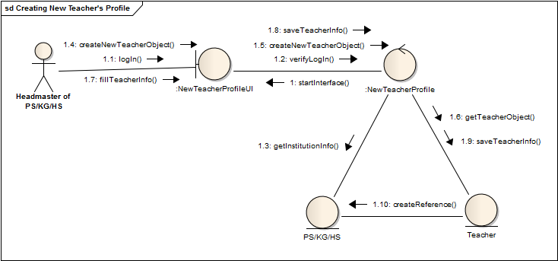

Slide 36
Monitoring Institution’s Performance
Use case: Institution’s Performance Monitoring and
Taking Proper Steps

Slide 37
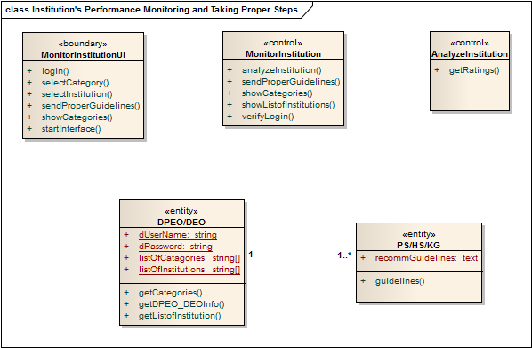

Slide 38
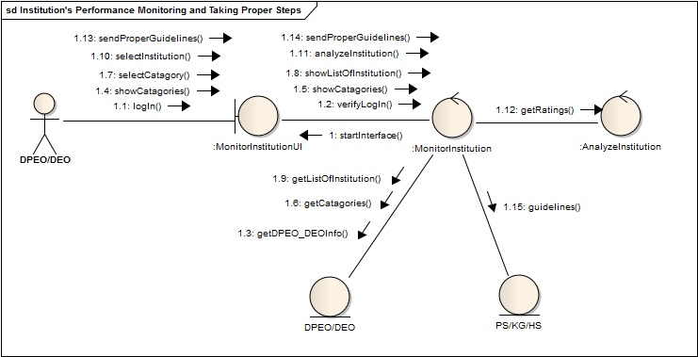

Slide 39
Book Distribution
Use Case: Calculating Total Number of Students

Slide 40
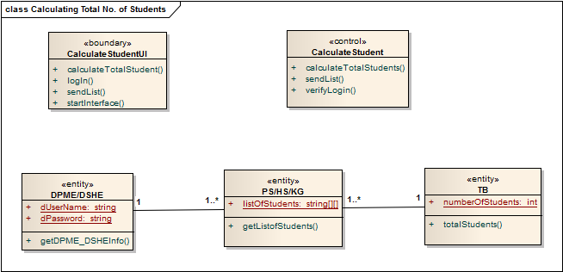

Slide 41
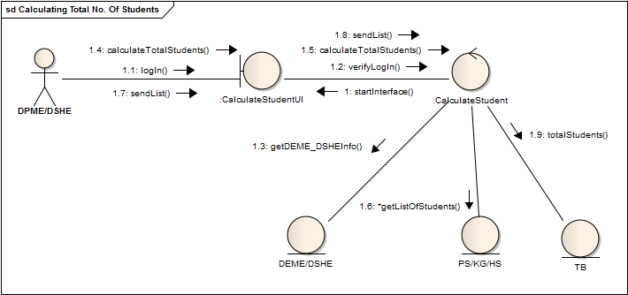

Slide 42
Book Distribution
Use case: Monitoring Book Distribution Process

Slide 43
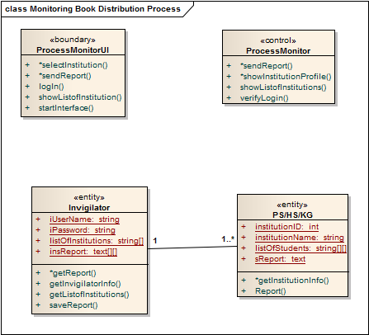

Slide 44
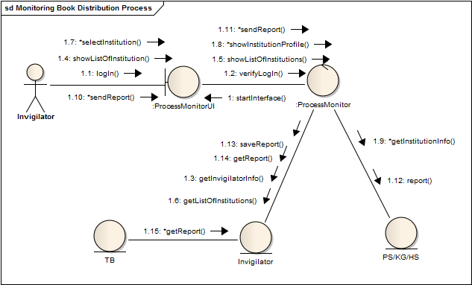

Slide 45
Book Distribution
Use case: Scheduling Book Distribution Process

Slide 46
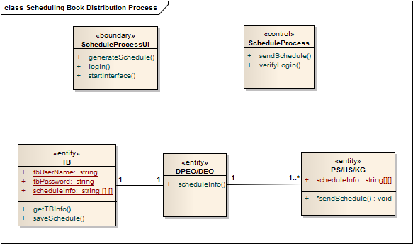

Slide 47
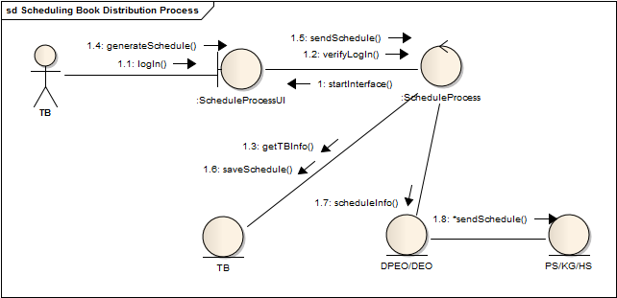

Slide 48


